Slide 1
Diyala University / College of Education for Humanities
Asst . Inst. Eman Ahmed Hasson
Methods of Teaching English
Second Grade
The Second Lecture
Exploration of Teaching

Slide 3
Exploration of Teaching
-what are ways to explore teaching?
1-Read articles and books about teaching and learning.

Slide 4
2-Read teachers narratives.
3-Attend professional
conferences.
4-Establish a mentoring relationship.
5-Put together a teaching portfolio.

Slide 5
6-Learn another language.
7-Do action research.
8-Do self-observation.
9-Observe other teachers.

Slide 6
10-Talk with other teachers.
11-Keep a teacher journal.

Slide 7
How can teachers explore teaching through self-observation?
Bailey, Curtis, and Nunan (2001) point out that self-observation is the cornerstone for all professional
development.

Slide 8
The cycle of teaching :
-Describing .
-Analyzing.
-Interpreting .
-Generating changes.

Slide 9
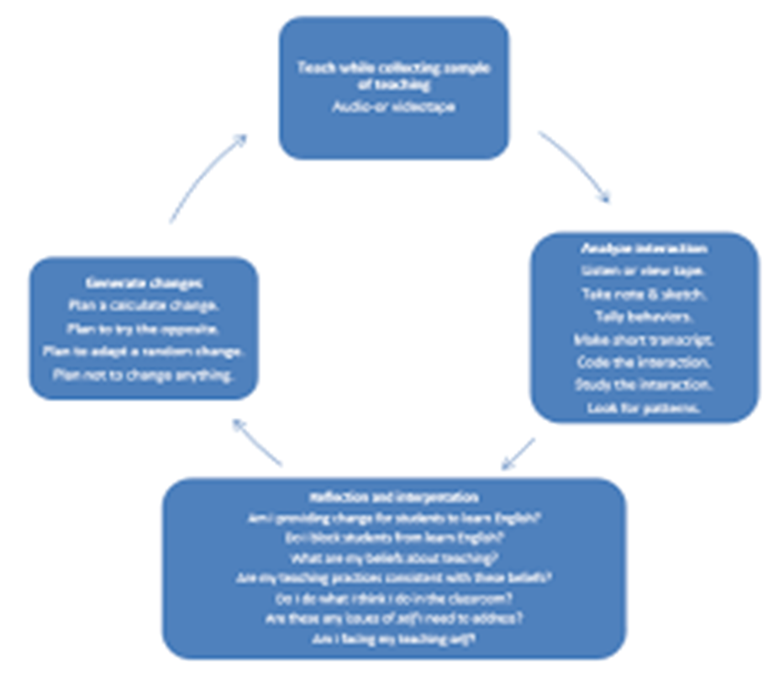

Slide 10
Teaching while Collecting Samples of Classroom Interaction
To make self-observation possible, we can collect samples of our teaching, and this can be done in a variety
of ways-Audio or video taping.

Slide 11
Analyzing samples of teaching
An analysis can also depend on the objective of the exploration

Slide 12
Interpreting and reflecting
To do this we need to focus on several questions.

Slide 13
Deciding on teaching behavior
This can be done through asking questions as: "What do I want to continue to do?" and "What small changes do I want to make in my teaching behavior?

